Slide 1
Chapter 1 The Foundations : Logic and Proofs
Asst. Prof. Yaowarat Sirisathitkul
syaowara@wu.ac.th
Office : C3 Room 254
Phone: 2272

Slide 2
Outline
Propositional logic
Propositional equivalences
Rules of Inferences
Introduction to Proofs
Proof Methods and Strategy

Slide 3
Introduction
Logic is the basis of all mathematical reasoning, and of all automated reasoning
To understand mathematics, we must understand what makes up a correct mathematical argument, that is, a proof
Proofs are used to verify that computer programs produce the correct output for all possible input values, to show that algorithms always produce the correct result, to establish the security of a system, and to create artificial intelligence
Furthermore, automated reasoning systems have been created to allow computers to construct their own proofs

Slide 4
Tools for reasoning: Logic
Introduction to Propositional Logic
Truth values, truth tables
Boolean logic: ∨ ∧ ¬
Conditional statement: → ↔

Slide 5
Propositions
A proposition is a declarative sentence that is either true or false, but not both.
The conventional letters used for propositional variables are p,q,r,s,…
Propositions:
Walailak University is in Thailand.
Walailak University is in downtown Nakhon Si Thammarat.
All students at Walailak University are SWE major.
1 + 1 = 2
Not propositions:
Do you like this class?
There are x students in this class.
What time is it ? (not declarative)
Read this carefully. (not declarative)
x + 1 = 2 (neither true nor false)

Slide 6
Logical operators and truth table
A truth table displays the relationships between the truth values of propositions.
Table 1. The truth table for the Negation (not) of a Proposition
eg. p : “ Today is Friday.”
﹁p : “ Today is not Friday.”
Table 2. The truth table for the Conjunction (and) of two propositions.
eg. p : “ Today is Friday.”
q : “ It’s raining today. ”
p ∧ q : “ Today is Friday
and it’s raining today. “
p | ﹁ p
T | F
F | T
p | q | p ∧ q
T | T | T
T | F | F
F | T | F
F | F | F

Slide 7
Logical operators and truth table (contd.)
Table 3. The truth table for the Disjunction (or) of two propositions.
eg. p : "Today is Friday. "
q : "It’s raining today . "
p ∨ q : "Today is Friday or it’s raining today. "
Table 4. The truth table for the Exclusive or (xor) of two propositions.
eg. p : "Today is Friday. "
q : " It’s raining today. "
p ⊕ q : "Either today is Friday or it’s raining today, but not both."
p | q | p ∨ q
T | T | T
T | F | T
F | T | T
F | F | F
p | q | p ⊕ q
T | T | F
T | F | T
F | T | T
F | F | F

Slide 8
Conditional statement
Table 5. The truth table for the Conditional statement of two propositions.
Implication (p implies q) p → q
eg. p : “ You make more than $25000 ”
q : “ You must file a tax return. “
p → q : “ If you make more …
then you must … . “
p is called the hypothesis (or antecedent or premise) and q is called the conclusion (or consequence)
Some of the more common ways of expressing this implication are :
(1) if p then q (6) q if p
(2) p implies q (7) q whenever p
(3) p only if q (8) q is necessary condition for p
(4) If p,q
(5) p is a sufficient condition for q
p | q | p → q | ¬ p ∨ q
T | T | T | T
T | F | F | F
F | T | T | T
F | F | T | T

Slide 9
Conditional statement
Converse, Inverse, Contrapositive
Some terminology, for an implication p → q
Its converse is q → p
Its inverse is: ¬p → ¬ q
Its contrapositive: ¬q → ¬ p
It means that
p → q ≡ ¬q → ¬ p (same truth table)
q → p ≡ ¬p → ¬ q (same truth table)

Slide 10
Conditional statement(contd.)
When 2 compound propositions always have the same truth value we call them equivalent
Logical equivalence (if and only if)
p → q ≡ ¬p ∨ q
Table 6. The truth table for the Biconditional p ↔ q
( p → q and q → p )
“p is necessary and sufficient for q”
“p iff q ” (“p if and only if q”)
“If p then q , and conversely.”
p | q | p → q | q → p | p ↔ q
T | T | T | T | T
T | F | F | T | F
F | T | T | F | F
F | F | T | T | T

Slide 11
Truth tables of Compound propositions
Construct the truth table of the compound proposition
( p ∨ ¬ q ) → ( p ∧ q )
p | q | ¬ q | p ∨ ¬ q | p ∧ q | ( p ∨ ¬ q ) → ( p ∧ q )
T | T | F | T | T | T
T | F | T | T | F | F
F | T | F | F | F | T
F | F | T | T | F | F

Slide 12
Translating English Sentences into Logical Expression
Example: How can the following English sentence be translated into a logical expression ?
“You can access the Internet from campus only if you are a computer science major or you are not a freshman. ”
Sol :
p : “You can access the Internet from campus.”
q : “You are a computer science major.”
r : “You are a freshman.”
∴ p only if ( q or ( ﹁ r ))
=> p → ( q ∨ ( ﹁ r ))

Slide 13
Translating English Sentences into Logical Expression (Contd.)
Example: You cannot ride the roller coaster if you are under 4 feet tall unless you are older than 16 years old.
Sol : q : “ You can ride the roller coaster. “
r : “ You are under 4 feet tall. “
s : “ You are older than 16 years old. “
∴ ﹁q if r unless s
∴ ( r ∧ ﹁s ) → ﹁q
Table 8. Precedence of Logical Operators
Operator | Precedence
﹁ | 1
∧ | 2
∨ | 3
→ | 4
↔ | 5
Compound Propositions
Example: p ∧ q ∨ r : Could be interpreted as (p ∧ q) ∨ r or p ∧ (q ∨ r)
precedence order: ¬ ∧ ∨ → ↔ (IMP!) (Overruled by brackets)
We use this order to compute truth values of compound propositions.
eg. (1) p ∧ q ∨ r means ( p ∧ q ) ∨ r
(2) p ∨ q → r means ( p ∨ q ) → r
(3) p ∧ ﹁ q means p ∧ ( ﹁ q )

Slide 14
Translating English Sentences into Logical Expression (Contd.)
Ex: “The system is in multiuser state if and only if it is operating normally. If the system is operating normally, the kernel is functioning. The kernel is not functioning or the system is in interrupt mode. If the system is not in multiuser state, then it is in interrupt mode.”
Sol.:

Slide 15
Propositional Equivalences
The propositions p and q that have the same truth values in all possible cases are called logically equivalent (สมมูลกันเชิงตรรกะ) or propositional equivalent (สมมูลกันเชิงประพจน์).
The notation p ≡ q ( or p ⇔ q ) denotes that p and q are logically equivalent.
Example: Show that ﹁( p ∨ q ) ≡ ﹁p ∧ ﹁q
pf :
p | q | ﹁( p ∨ q ) | ﹁p | ﹁q | ﹁p ∧ ﹁q
T | T | F | F | F | F
T | F | F | F | T | F
F | T | F | T | F | F
F | F | T | T | T | T

Slide 16
Tautology and Contradiction
A compound proposition that is always true is called a tautology (สัจนิรันดร์).
A compound proposition that is always false is called a contradiction (ขัดแย้ง).
Example 1 :
จากประพจน์ต่อไปนี้ ประพจน์ใดเป็นสัจนิรันดร์หรือข้อขัดแย้ง
p → ﹁ p
p ↔ ﹁ p
p ⊕ ﹁ p
p | ﹁p | p ∨ ﹁p | p ∧ ﹁p
T | F | T | F
F | T | T | F

Slide 17
Tautology and Contradiction (Contd.)
Verifying Tautologies
[﹁p ∧ (p ∨ q)] → q
Tautology by Truth Table
Tautology by Proof??
p | q | ﹁p | ( p ∨ q ) | ﹁p ∧ (p ∨ q) | [﹁p ∧ (p ∨ q)] → q
T | T
T | F
F | T
F | F

Slide 18
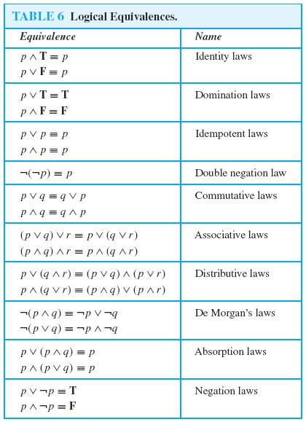
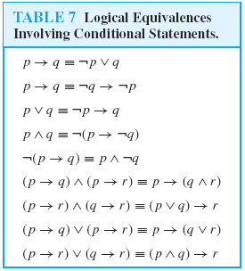
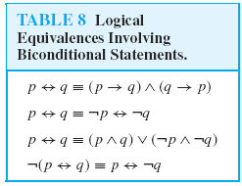
Equivalence Laws

Slide 19
Propositional Equivalences (contd.)
Example: Show that ﹁( p ∨ (﹁p ∧ q )) ≡ ﹁p ∧ ﹁q
pf :
﹁( p ∨ (﹁p ∧ q ) )
≡ ﹁p ∧ ﹁ (﹁p ∧ q ) De Morgan’s law
≡ ﹁p ∧ [﹁ (﹁p) ∨ ﹁q] De Morgan’s law
≡ ﹁p ∧ ( p ∨ ﹁q ) Double negation law
≡ (﹁p ∧ p ) ∨ ( ﹁p ∧ ﹁q ) Distribution law
≡ F ∨ ( ﹁p ∧ ﹁q ) Negation law
≡ ﹁p ∧ ﹁q Identity law
∴﹁( p ∨ (﹁p ∧ q )) ≡ ﹁p ∧ ﹁q

Slide 20
Propositional Equivalences (contd.)
Example: Show ( p ∧ q ) → (p ∨ q) is a tautology.
pf :
( p ∧ q ) → (p ∨ q) ≡ ﹁( p ∧ q ) ∨ (p ∨ q ) Imply
≡ ( ﹁p ∨ ﹁q ) ∨ (p ∨ q ) De Morgan’s law
≡ ( ﹁p ∨ p ) ∨ ( ﹁q ∨ q ) Associative law
≡ T ∨ T Negation law
≡ T Disjunction

Slide 21
Propositional Equivalences (contd.)
Example: Tautology by proof
( p ∧ q ) → (p → q) p → (q → r) ≡ (p ∧ q ) → r
Propositional Equivalent Proof

Slide 22
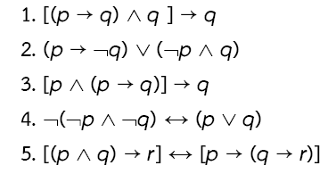
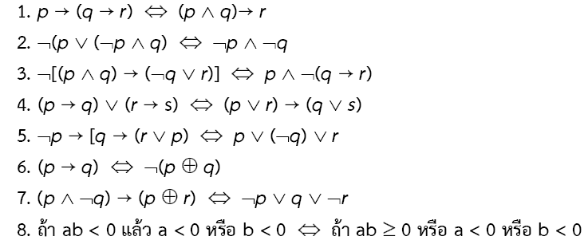
Propositional Equivalences (contd.)
Example: Tautology by proof
Propositional Equivalent Proof

Slide 23
Propositional Functions & Predicates
A predicate (ภาคแสดง) is a proposition that is a function of one or more variables.
The statement P(x) is said to be the value of the propositional function P at x.
P(x) : “ x is greater than 3 “
E.g.: P(x): x is an even number. So P(1) is false, P(2) is true,….
Examples of predicate functions:
Domain ASCII characters - IsAlpha(x) : TRUE iff x is an alphabetical character.
Domain floating point numbers - IsInt(x): TRUE iff x is an integer.
Domain integers: Prime(x) - TRUE if x is prime, FALSE otherwise.
variable
predicate

Slide 24
Two Popular Quantifiers
Universal quantifier : ∀x P(x) – “P(x) for all x in the domain” (for all, for every)
Existential quantifier : ∃x P(x) – “P(x) for some x in the domain” or “there exists x such that P(x) is TRUE”. (there exists, there is, for some)
Either is meaningless if the domain is not known/specified.
Examples (domain real numbers)
∀x (x² >= 0)
∃x (x >1)
(∀x>1) (x² > x) – quantifier with restricted domain

Slide 25
Rules of Inference
Rules of inference are our basic tools for establishing the truth of statements
The main goal of logic: when is a given argument valid?
An argument has the form: “S₁,…,S_{n}. Therefore, Q.”
Our goal is to determine whether C is true under the assumption that each of P₁,…,P_{n} is true.
An inference is an expression of the form
the inference P₁,…,P_{n} → C is valid
P₁,…,P_{n} are called the premises or hypotheses, C is called the conclusion of the inference
The inference is valid if (P₁ ∧ … ∧ P_{n} ) → C is a tautology
When the inference is valid, we also say that C is a logical conclusion of the premises P₁,…,P_{n}

Slide 26
Rules of Inference (contd.)
Ex. Is the following argument valid?
If x = 4, then discrete math is bad. Discrete math is bad. Therefore, x = 4
Ans:
Denote “x = 4” by p and “discrete math is bad” by q
Translated to the inference {p → q, q} → p
We need to determine whether [ (p → q) ∧ q ] → p is a tautology or not
Consider the assignment f with f(p) = F and f(q) = T
In this assignment
p → q is T;
(p → q) ∧ q is T;
consequently, (p → q) ∧ q → p is F
Hence, the argument is invalid

Slide 27
Rules of Inference (contd.)
Ex. Is the following argument valid?
If discrete math is bad, then x = 4. Discrete math is bad. Therefore, x = 4
Ans:
Denote “x = 4” by p and “discrete math is bad” by q
Translated to the inference {q → p, q} → p
We need to determine whether [ (q → p) ∧ q ] → p is a tautology
Suppose there is an assignment for which [ (q → p) ∧ q ] → p take the value F
p must be F and (q → p) ∧ q must be T
As (q → p) ∧ q is T; q must be T and q → p must be T
Thus p is F, q is T, and q → p is T. This is impossible
Hence, there is no assignment for which [ (q → p) ∧ q ] → p is F. Hence it is a tautology
So p logically follows from q → p and q. That is, {q → p, q} → p. The argument is valid

Slide 28
Rules of Inference (contd.)
The tautology [p ∧ (p→q)] → q is the basis of the rule of inference called Modus Ponens
Suppose p and p → q are T
p hypothesis
p→q conditional statement
∴q
Modus Ponens tell us that if a conditional statement and the hypothesis of this conditional statement are both true, then the conclusion must also be true.

Slide 29
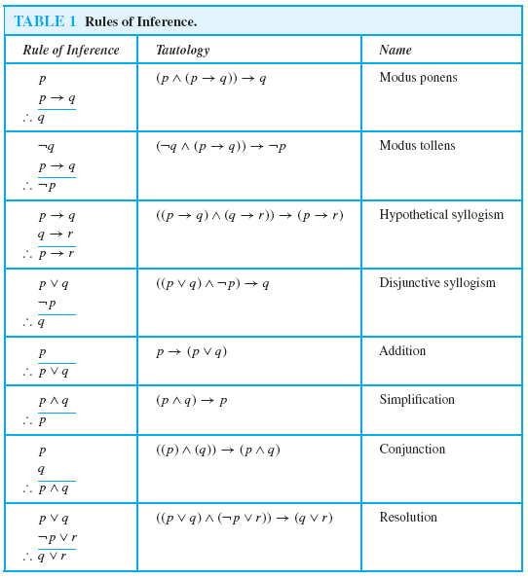
Rules of Inference (contd.)

Slide 30
Rules of Inference (contd.)
Example : Show that the hypotheses “It is not sunny this afternoon and it is colder than yesterday”, “We will go swimming only if it is sunny”, “If we do not go swimming, then we will take a canoe trip”, and “If we take a canoe trip, then we will be home by sunset” lead to the conclusion “We will be home by sunset”
The first step is to identify propositions and use propositional variables to represent them.
p- “It is sunny this afternoon” q- “It is colder than yesterday”
r- “We will go swimming” s- “We will take a canoe trip”
t- “We will be home by sunset”
The hypotheses are – ¬p∧q, r→p, ¬r→s, and s→t
The conclusion is – t

Slide 31
Rules of Inference (contd.)
Example : Show that the hypotheses “It is not sunny this afternoon and it is colder than yesterday”, “We will go swimming only if it is sunny”, “If we do not go swimming, then we will take a canoe trip”, and “If we take a canoe trip, then we will be home by sunset” lead to the conclusion “We will be home by sunset”
The hypotheses are – ¬p∧q, r→p, ¬r→s, and s→t
The conclusion is – t
Step | Reason
1. ¬p∧q | Hypothesis
2. ¬p | Simplification
3. r→p | Hypothesis
4. ¬r | Modus Tollens using (2) and (3)
5. ¬r→s | Hypothesis
6. s | Modus Ponens using (4) and (5)
7. s→t | Hypothesis
8. t | Modus Ponens using (6) and (7)

Slide 32
Rules of Inference (contd.)
Example : Show that the hypotheses “If you send me an email message, then I will finish writing the program”, “If you do not send me an e-mail message, then I will go to sleep early”, and “If I go to sleep early, then I will wake up feeling refreshed” lead to the conclusion “If I do not finish writing the program, then I will wake up feeling refreshed”
The first step is to identify propositions and use propositional variables to represent them.
p- “You send me an email message” q- “I will finish writing the program”
r- “I will go to sleep early” s- “I will wake up feeling refreshed”
The hypotheses are – p → q, ¬p→r, and r→s
The conclusion is – ¬q→s

Slide 33
Rules of Inference (contd.)
Example : Show that the hypotheses “If you send me an email message, then I will finish writing the program”, “If you do not send me an e-mail message, then I will go to sleep early”, and “If I go to sleep early, then I will wake up feeling refreshed” lead to the conclusion “If I do not finish writing the program, then I will wake up feeling refreshed”
The hypotheses are – p → q, ¬p→r, and r→s
The conclusion is – ¬q→s
Step | Reason
1. p → q | Hypothesis
2. ¬q → ¬p | Contrapositive of (1)
3. ¬p→r | Hypothesis
4. ¬q → r | Hypothetical syllogism using (2) and (3)
5. r→s | Hypothesis
6. ¬q→s | Hypothetical syllogism using (4) and (5)

Slide 34
Rules of Inference (contd.)
Example:
¬p, (¬( p ∨ q ) → s), ¬s ∴q ¬p → t, q → s, r → q, ¬(q ∨ t) ∴p

Slide 35
Inference and Automatic Theorem-Proving
The steps in an inference are useful for proving assertions from axioms and facts.
Why is it important for computers to prove theorems?
Proving program-correctness
Hardware design
Data mining
…..
Sometimes the steps of an inference (proof) are useful. E.g. on Amazon book recommendations are made.
You can ask why they recommended a certain book to you (reasoning).

Slide 36
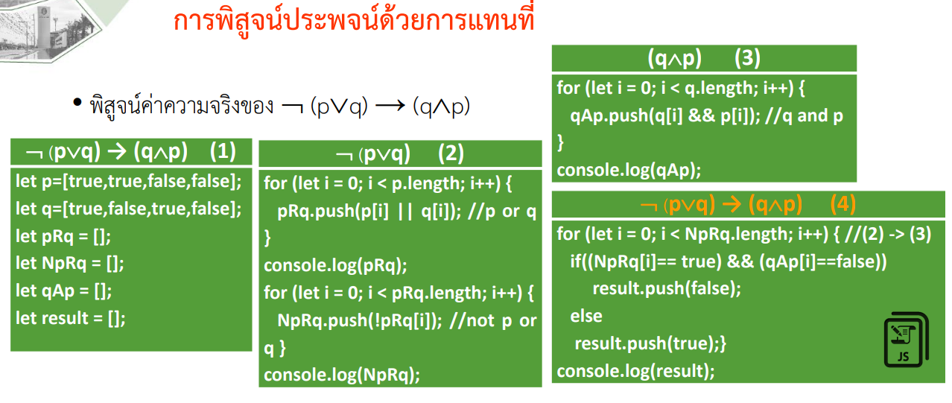
36

Slide 37
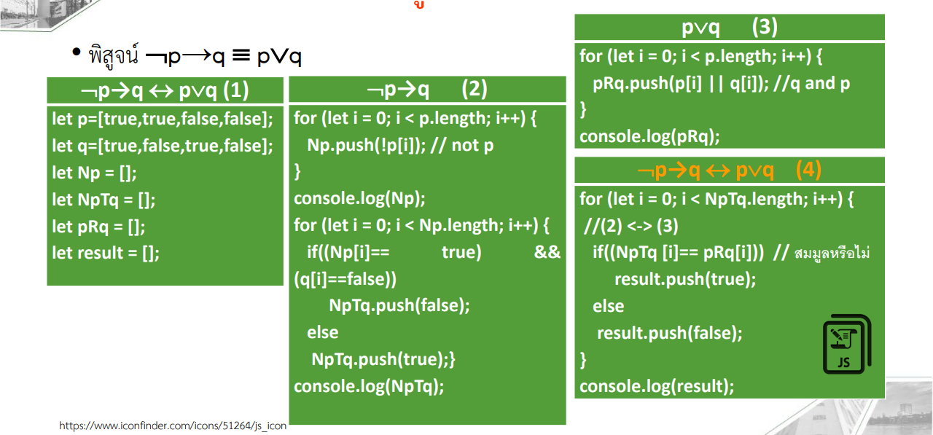
37

Slide 38
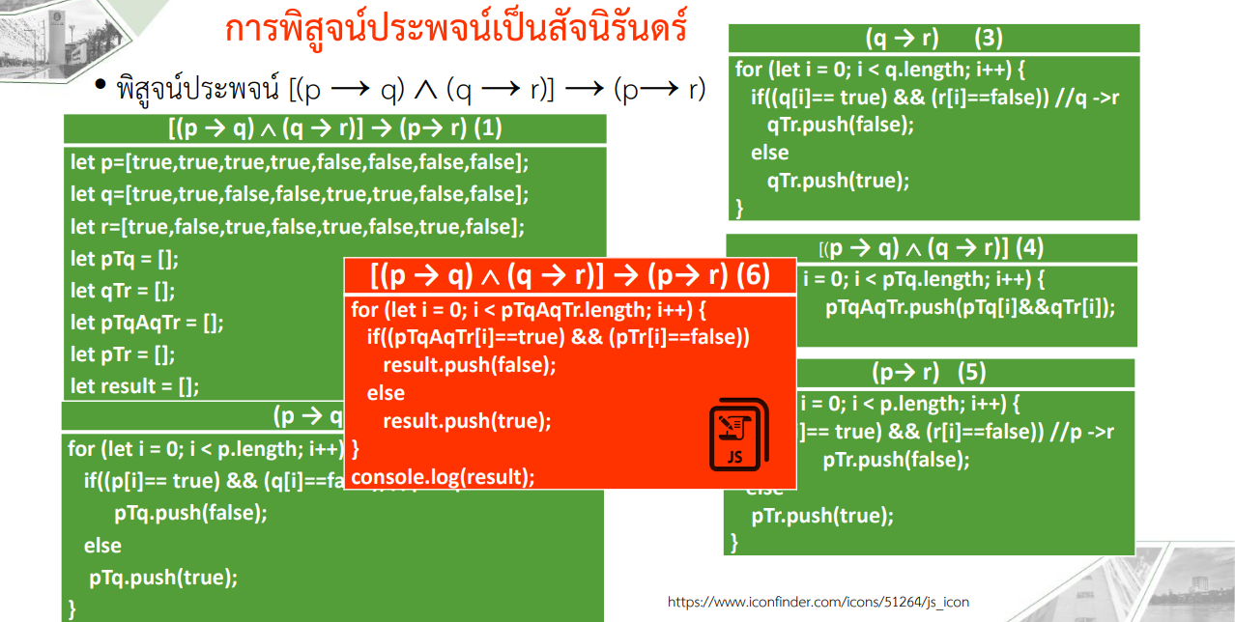
38

Slide 39
Introduction to proofs
Proof is a valid argument that establishes the truth of a mathematical statement, e.g., theorem
A proof can use hypotheses, axioms, and previously proven theorems
Formal proofs: can be extremely long and difficult to follow
Informal proofs: easier to understand and some of the steps may be skipped, or axioms are not explicitly stated
http://methodsofproof-myblog.blogspot.com/2011/09/blog-post.html
39

Slide 40
Some terminology
Theorem: a mathematical statement that can be shown to be true
Proposition: less important theorem (referred to as facts or results)
Axiom (postulate): a statement that is assumed to be true
Lemma: less important theorem that is helpful in the proof of other results
Corollary: a theorem that can be established directly from a theorem that has been proved
Conjecture: a statement proposed to be true, but not proven yet

Slide 41
Types of Proofs
When one wishes to prove the statement p → q there are fundamental approaches
Direct proofs
Proof by contrapositive
Proof by contradiction

Slide 42
Types of Proofs (contD.)
The following three definitions are central to the execution of our proofs:
Definition 1. An integer number n is even if and only if there exists a number k such that n = 2k.
Definition 2. An integer number n is odd if and only if there exists a number k such that n = 2k + 1.
Definition 3. Two integers a and b are consecutive if and only if b = a + 1

Slide 43
Direct Proofs (วิธีพิสูจน์โดยตรง)
Direct proofs of p→q
In a constructive proof one attempts to demonstrate p → q directly.
This is the simplest and easiest method of proof available to us.
There are only two steps to a direct proof (the second step is, of course, the tricky part):
1. Assume that p is true.
2. Use p to show that q must be true
Showing that if p is true, then q must also be true

Slide 44
E.g.: Proof using Direct Proof
Ex the truth or falsity of the following statement: The sum of any two consecutive numbers is odd. e.g. 1 + 2 , 2 + 3, 11+12
Show “If a and b are consecutive integers, then the sum a + b is odd”.
Proof. To construct a proof by direct proof, Assume that p is true. Use p to show that q must be true.
Because a and b are consecutived we know that b = a + 1.
Thus, the sum a + b may be re-written as 2a + 1.
Thus, there exists a number k such that a + b = 2k + 1 so the sum a + b is odd.

Slide 45
E.g.: Proof using Direct Proof
Ex “If n is an odd integer, then n² is odd”
Proof: To construct a proof by direct proof, Assume that p is true. Use p to show that q must be true
By definition of odd integer, n = 2k+1, where k is some integer
n² = (2k+1)² = 4k²+4k+1 = 2(2k²+2k)+1
By definition of odd integer, we conclude n² is an odd integer (it is one more than twice an integer)
Consequently, we prove that if n is an odd integer, then n² is odd

Slide 46
E.g.: Proof using Direct Proof
Ex “If m and n are both perfect squares, then nm is also a perfect square (an integer a is a perfect square if there is an integer b such that a = b²)
We assume that the hypothesis of this conditional statement is true, we assume that m and n are both perfect squares
Proof: To construct a proof by direct proof, Assume that p is true. Use p to show that q must be true
By definition, there are integers s and t such that m = s², and n = t²
Thus, mn = s²t² = (st)² (using commutative and associative of multiplication)
We conclude mn is also a perfect square, because it is the square of st, which is an integer.

Slide 47
Proof by contrapositive (การพิสูจน์โดยใช้การแย้งสลับที่)
Indirect proof: sometimes direct proof leads to dead ends
Proof by contraposition can be an effective approach when a traditional direct proof is tricky, or it can be a different way to think about the substance of a problem.
Based on contrapositive proof
By saying that the two propositions are equivalent we mean that if one can prove p → q then they have also proved ¬q → ¬p, and vice versa
There are only two steps to a contrapositive proof :
1. Assume that ¬q is true.
2. Use ¬q to show that ¬p must be true
Showing that if ¬q is true, then ¬p must also be true

Slide 48
E.g.: Proof using contrapositive
Ex. Show that “if n is an integer and 3n+2 is odd, then n is odd”
Proof by Direct proof Assume that p is true. Use p to show that q must be true
Assume 3n+2 is odd, this means that 3n+2 = 2k+1, for some k
Can we use this fact to show that n is odd?
We see that 3n+1 = 2k, but there does not seem to be any direct way to conclude that n is odd

Slide 49
E.g.: Proof using contrapositive
Ex. Show that “if n is an integer and 3n+2 is odd, then n is odd”
Proof by contrapositive: ¬q → ¬p
if n is not odd, then n is not an integer or 3n+2 is not odd
Assume n is even, i.e., n = 2k, for some k, substituting 2k for n
It follows 3n+2 = 3(2k)+2 = 6k+2 = 2(3k+1)
Thus 3n+2 is even (because it is a multiple of 2) and therefore not odd
Because the negation of the conclusion of the conditional statement implies that the hypothesis is false, the original condition statement is true

Slide 50
E.g.: Proof using contrapositive
Show “If a and b are consecutive integers, then the sum a + b is odd”.
Proof. To construct a proof by contrapositive, ¬q → ¬p
If the sum a + b is not odd, then a and b are not consecutive integers.
Assume that the sum of the integers a and b is even.
Then, there exists integer k such that a + b = 2k.
Thus, a + b = 2k = k + k for all integers k.
Because k is not the successor of k, this implies that a and b cannot be consecutive integers.
Because the negation of the conclusion of the conditional statement implies that the hypothesis is false, the original condition statement is true

Slide 51
Proof by contradiction (การพิสูจน์โดยข้อขัดแย้ง)
The proof by contradiction is grounded in the fact that any proposition must be either true or false, but not both true and false at the same time.
We arrive at a contradiction when we are able to demonstrate that a statement is both simultaneously true and false, showing that our assumptions are inconsistent.
We can use this to demonstrate p → q by assuming both p and ¬q are simultaneously true and deriving a contradiction
When we derive this contradiction, it means that one of our assumptions was untenable.
Presumably we have either assumed or already proved p to be true so that finding a contradiction implies that ¬q must be false

Slide 52
Proof by contradiction (CONTD.)
The method of proof by contradiction.
1. Assume that p is true.
2. Assume that ¬q is true.
3. Use p and ¬q to demonstrate a contradiction
It doest not prove a result directly, it is another type of indirect proof

Slide 53
E.g.: Proof using contradiction
Ex If a and b are consecutive integers, then the sum a + b is odd
Proof. To construct a proof by contradiction, assume both p and ¬q are true
1. Assume that a and b are consecutive integers.
2. Assume also that the sum a + b is not odd.
Because the sum a + b is not odd, there exists number k such that a + b = 2k = k + k.
Thus, we have derived that a = k and b = k for any integer k and a and b are not consecutive integers
This is a contradiction.
Or
Because the integers a and b are consecutive, so we may write the sum a + b = a + (a+1) = 2a + 1.
Thus, we have derived that a + b = 2k + 1 for any integer k and also that a + b is odd.
This is a contradiction.

Slide 54
E.g.: Proof using contradiction
Ex. Proof by contradiction “If 3n+2 is odd, then n is odd”
Proof. To construct a proof by contradiction, assume both p and ¬q are true
Let p be “3n+2 is odd” and q be “n is odd”
To construct a proof by contradiction, assume both p and ¬q are true
That is, assume that 3n+2 is odd and that n is not odd
Since n is even, let n = 2k, then 3n+2 = 6k+2 = 2(3k+1).
So 3n+2 is even, i.e. ¬p,
Both p and ¬p are true, so we have a contradiction

